Slide 1

Note: The data and information in this document is reflective of a hypothetical situation and client. This document is to be used for KPMG Virtual Internship purposes only.
Sprocket Central Pty Ltd
Data analytics approach
[Division Name] - [Engagement Manager], [Senior Consultant], [Junior Consultant]

Slide 2
Note: The data and information in this document is reflective of a hypothetical situation and client. This document is to be used for KPMG Virtual Internship purposes only.
Agenda
Introduction
Data Exploration
Model Development
Interpretation

Slide 3
Note: The data and information in this document is reflective of a hypothetical situation and client. This document is to be used for KPMG Virtual Internship purposes only.
Introduction
Sprocket Central Pty Ltd which specializes in high-quality bikes and accessible cycling accessories to riders. To boost business we need to understand the customer trends and behavior so that we can focus on customers which are more likely to purchase .
PROBLEM STATEMENT :
Understanding customer trends and behavior , finding important customers thus optimizing marketing budget and using it efficiently.
We can look into existing customers and understand the trend and focus on those particular customers
Check existing and new customers based on:
Age distributions with gender
Number of bike purchases in 3 years / percentages purchases
Job industry category and title
Wealth segments
Number of cars own and tenure.
Check our important customers and their postal codes.

Slide 4
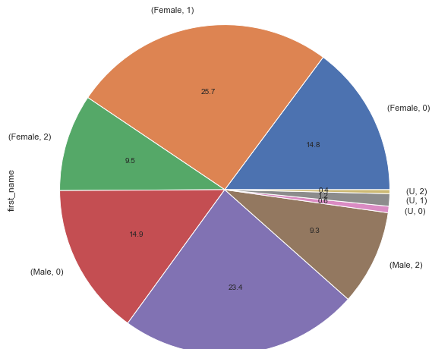
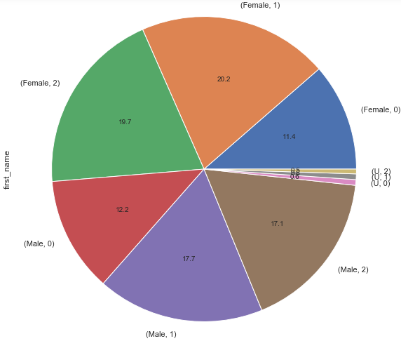
Note: The data and information in this document is reflective of a hypothetical situation and client. This document is to be used for KPMG Virtual Internship purposes only.
Data Exploration
Customers’ age distribution with gender
Old customers
New
New customers
.

Slide 5
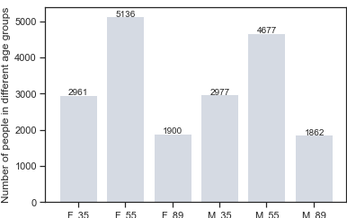
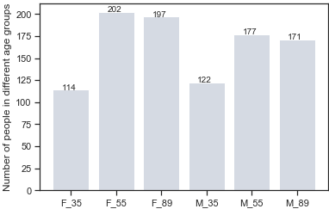
Note: The data and information in this document is reflective of a hypothetical situation and client. This document is to be used for KPMG Virtual Internship purposes only.
Data Exploration
Customers’ age distribution
Old
As we can infer is that majority of the customer is from second group of female i.e. females between 35 to 55 in both old and new customers followed by male of this age group.
Number of customers from 55 to 89 years old has big increase on percentages specially in males i.e around 84%.
There is decrease in customers of age group 1 i.e. 35 to 55 years old.
There’s not much change in the first age group that is customers below 35.
New

Slide 6
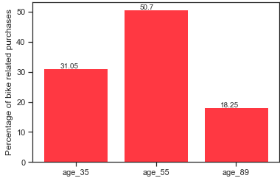
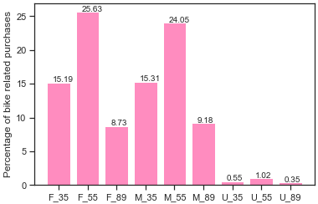
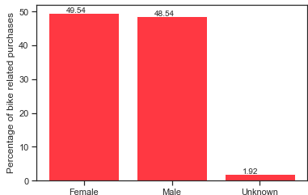
Note: The data and information in this document is reflective of a hypothetical situation and client. This document is to be used for KPMG Virtual Internship purposes only.
Data Exploration
Bike purchases last 3 years
We can infer that when bike purchase in last 3 years across gender , there is very minute change in existing and new customers. Purchase made by female is more compared to men.
When checked across different age groups maximum purchase was made by grp1 i.e. customers between 35 to 55 age.
And when checked with gender and age groups the maximum purchase was made by female between 35-55 followed by male 35-55yrs. And the least excluding unknown was by female above 55years followed by male of older age.

Slide 7
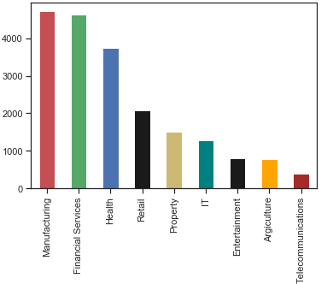
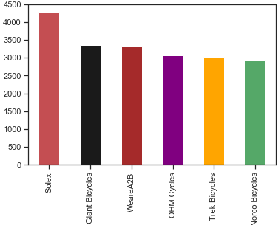
Note: The data and information in this document is reflective of a hypothetical situation and client. This document is to be used for KPMG Virtual Internship purposes only.
Data Exploration
Job industry category and brand
As we can see most of our customers are from manufacturing and financial services. So later we can focus on customers which are in these job category. Because they can be our important and trusted customers.
Customers from Telecommunications and Agriculture job category are the least.
If seen within brands Solex followed by Giant Bicycles were liked and bought by majority of the customers.

Slide 8
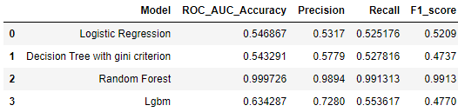
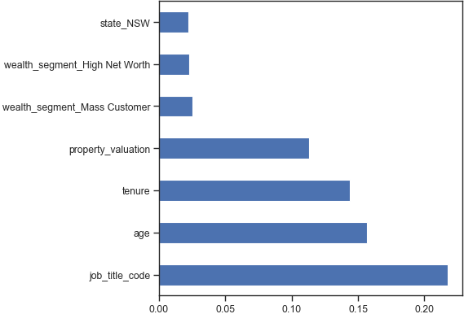
Note: The data and information in this document is reflective of a hypothetical situation and client. This document is to be used for KPMG Virtual Internship purposes only.
Model Development
For building ML model we have created new “Label” which is whether the customer will purchase or not based on few constraints. The label is based on the median value of past 3 years purchase of the customer. If the purchase is more than median we consider that customer to be a trusted customer and they are most likely to purchase our bikes.
We have label encoded the job title because it is more in number and dummy encoded all the categorical variables.’
We have used classification models like logistic regression , decision tree classifier, random forest classifier , lgbm.
From the above result we can observe that the highest roc_auc_accuracy score was achieved from Random Forest with value 99.97% area in the roc curve.
We can observe that the important features from our Random Forest model are State_NSW , Wealth_Segment_high_net_Worth , Wealth_segment_mass_customer , property_valuation , tenure , age , job_title_code.
We will further perform statistical tests on these important features.

Slide 9
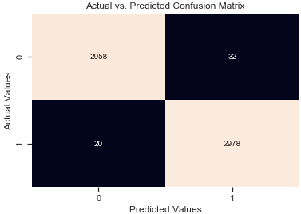
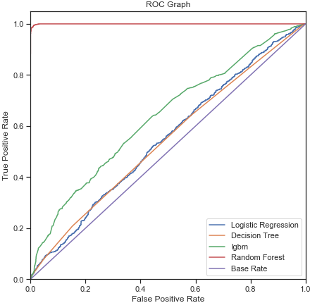
Note: The data and information in this document is reflective of a hypothetical situation and client. This document is to be used for KPMG Virtual Internship purposes only.
Model Development
True positives: 2978 (Customers which are trusted customers and were predicted as trusted customer)
True Negative: 2958 (Customers which were predicted as not trusted customers and were actually not trusted customers)
False Positive: 32 (Customers which were predicted as trusted customers but actually were no trusted customers.)
False Negative: 20 (Customers which were predicted as non trusted but actually were trusted customers.
Precision=TP/ (TP+FP) =2978/ (2978+32) =0.9893
Recall=TP/ (TP+FN) =2978/ (2978+20) =0.9933.
We can see the maximum area was covered by Random forest.In our model type I and type II error is also very less.

Slide 10


Note: The data and information in this document is reflective of a hypothetical situation and client. This document is to be used for KPMG Virtual Internship purposes only.
Model Development
Statistical Tests.
As the pvalue is more than 0.05 so for 95% confidence interval we fail to reject the null hypothesis and can infer that the age distribution is same in all the three wealth segment.
That is all the different age group people are present in all the thre wealth group segment.
Wealth segment with age:
Ho : Mean age of different wealth segment is same.
Ha: Mean age of different wealth segment is significantly different.
Age group with past 3 years bike related purchase:
As the pvalue is less than 0.05.So for 95%confidence interval we reject the null hypothesis i.e. mean of past 3 year purchase of different age groups is significantly different.
Ho : Mean of past 3 year purchase of different age groups customer is same
Ha: mean of past 3 year purchase of different age groups customers is significantly different.

Slide 11
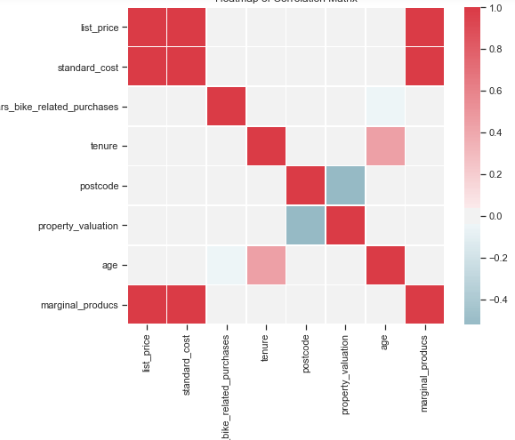
Note: The data and information in this document is reflective of a hypothetical situation and client. This document is to be used for KPMG Virtual Internship purposes only.
Interpretation
Correlation between different columns
So from correlation graph we can infer that
List price and standard cost are strongly correlated i.e. if the standard cost increase the list price increase and vice versa.
Tenure and age have a positive correlation. If the age of customers increase the tenure also increases.
Property valuation and post code have a negative correlation.

Slide 12
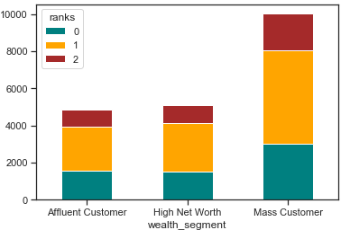
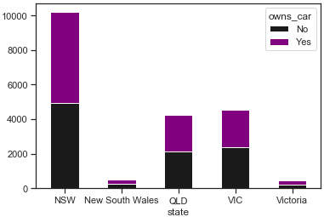
Note: The data and information in this document is reflective of a hypothetical situation and client. This document is to be used for KPMG Virtual Internship purposes only.
Interpretation
Wealth segments and state wise customer
In all ages, the number of Mass Customers is the highest so we should focus on this social class. And most of them belong to group 1 i.e. customers between 35 to 55 age.
After that, we should focus on High Net Customer. From our random forest model we got mass customer and high net worth wealth segment as important features for our model. It best describes our model.
Then Affluent Customers but mostly second and third quadrant.
If we look into states, majority of the customers are from NSW followed by VLC and the least is from New South wales and Victoria.
We can also infer that customer from every state owning car and not owning car are evenly distributed.

Slide 13
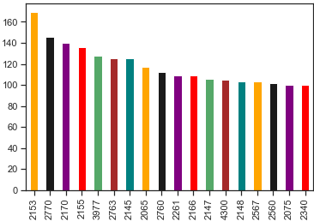
Note: The data and information in this document is reflective of a hypothetical situation and client. This document is to be used for KPMG Virtual Internship purposes only.
Interpretation
Postal code and interpretations
Majority of the customers are from these areas . These are the postal codes of customers. Maybe their home is near to their office and using bike or bicycle is more conventional. So we can focus on our future customers of these areas and make marketing plans accordingly.
Majority of the customers is women of 35 to 55 age group so we can give additional discounts to them so that we can get trusted customers.
Customers from NSW are more trusted customers. So we little advertisement can bring profit. But to increase bike sales we can put some customer attracting coupons and discounts in VLC as we are getting good revenue only from NSW.
Majority of our customers are in manufacturing or financial service job .Health is a little low. So we can try some new techniques to offer so that they find bike or bicycle convenient.

Slide 14
Note: The data and information in this document is reflective of a hypothetical situation and client. This document is to be used for KPMG Virtual Internship purposes only.
Appendix

